Slide 1
EE439 Discussions How do Uncertainty Impact Economic Activity?
Kantapong (ID: 6004640030)
Faculty of Economics, Thammasat University, Bangkok, Thailand

Slide 2


Reactions!
Writing a Paper (Last week)
Listening to my talk! (today)

Slide 3

How do Uncertainty Impact Economic Activity?
Economic Uncertainty Before and After Covid-19
Goal: Look at uncertainty measures before and after Covid-19
Impact of Policy Uncertainty on Economy
Goal: Survey methodology used for estimating the impact
Economic Policy Uncertainty (EPU) Index
Goal: Construct a toy example on EPU

Slide 4

Measures Used to Characterize Uncertainty
1. VIX: forward-looking volatility using options on S&P500
2. Newspaper-Based (EPU): reflect uncertainty perceived by journalists
3. Business-Expectation Surveys: subjective opinions on sales growth
4. Forecaster Disagreement: use disagreement in surveys
5. Time-Series Model: GARCH Model

Slide 5
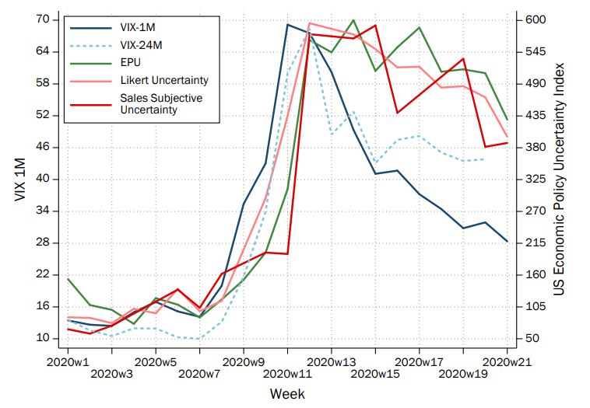

Uncertainty Spiked!
Source: Altig, D., Baker, S., Barrero, J.M., Bloom, N., Bunn, P., Chen, S., Davis, S.J., Leather, J., Meyer, B., Mihaylov, E. and Mizen, P., 2020. Economic uncertainty before and during the COVID-19 pandemic. Journal of Public Economics, 191, p.104274.

Slide 6
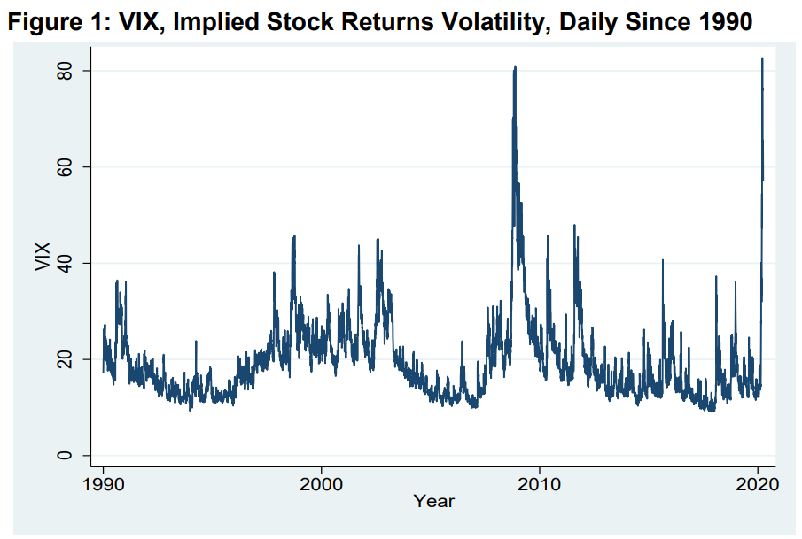

VIX Spiked in 2020
Source: Baker, S.R., Bloom, N., Davis, S.J. and Terry, S.J., 2020. Covid-induced economic uncertainty (No. w26983). National Bureau of Economic Research.

Slide 7
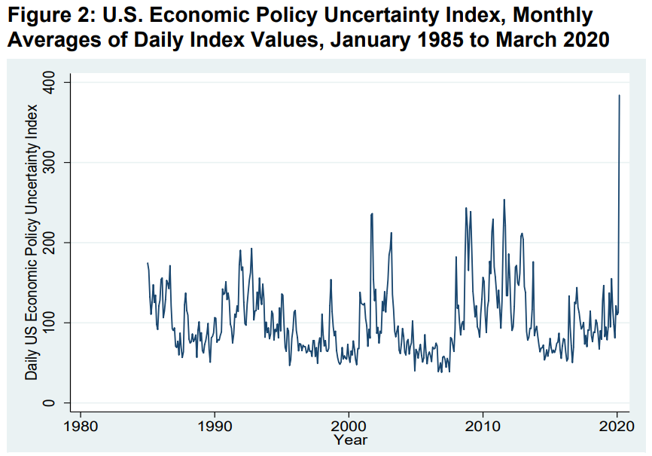
EPU Spiked in 2020
Source: Baker, S.R., Bloom, N., Davis, S.J. and Terry, S.J., 2020. Covid-induced economic uncertainty (No. w26983). National Bureau of Economic Research.

Slide 8
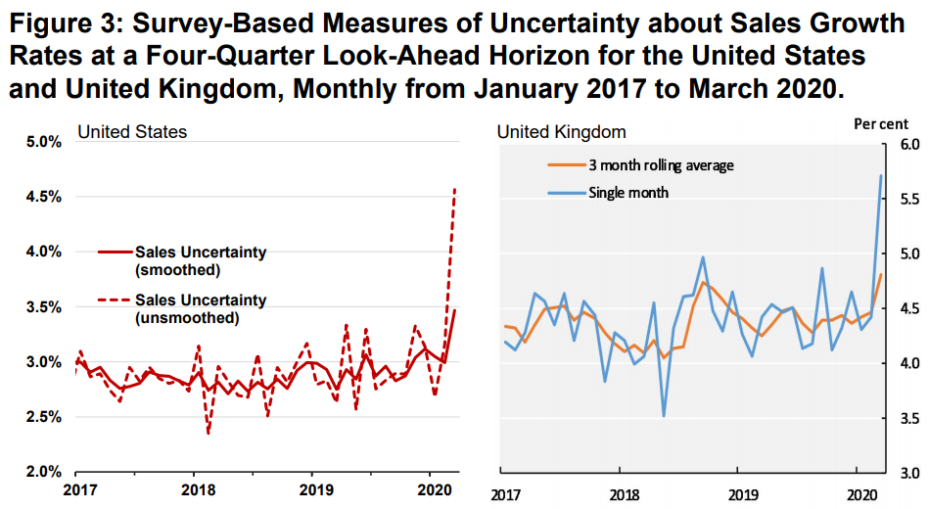
Survey-Based Measures Spiked in 2020
Source: Baker, S.R., Bloom, N., Davis, S.J. and Terry, S.J., 2020. Covid-induced economic uncertainty (No. w26983). National Bureau of Economic Research.

Slide 9
Effects of Policy Uncertainty on Economy
The main question is how policy uncertainty affects economic outcomes.
Two approaches used by Baker, Bloom and Davis (2016):
1. Use firm-level data to capture government purchases
Results: Policy uncertainty affects stock price uncertainty
2. Use macro-level data to capture multiple channels
Results: Policy uncertainty affects macro-variables such as
industrial production, employment growth.

Slide 10
Firm-Level Data
Dependent Variable: option-implied stock price volatility
Main independent variables: EPU index
Other control variables: VIX, Federal purchase per GDP, Exposure to Government purchases
Approach: Panel-data method, controlling for entity-fixed effect and time-fixed effect

Slide 11
Models
+
-
1) Vol = f(log(EPU); Fed Purchase/GDP)
2) Vol = f(log(EPU)*intensity; (Fed Purchase/GDP)*intensity; i, t)
3) Vol = f(log(EPU); log(VIX); Fed Purchase/GDP)
4) Vol = f(log(EPU)*intensity; log(VIX)*intensity; (Fed Purchase/GDP)*intensity; i, t)
+
-
-
+
-
+
-
-
Baker, S.R., Bloom, N. and Davis, S.J., 2016. Measuring economic policy uncertainty. The quarterly journal of economics, 131(4), pp.1593-1636.

Slide 12
Macro-Level Data
Approach: Use VAR with Cholesky decomposition
Variables: EPU index, log(S&P500), federal funds rate, log employment, log industrial production (each for 3 lags)
Visualization: Impulse response function of industrial production and employment to 90-point EPU innovation

Slide 13
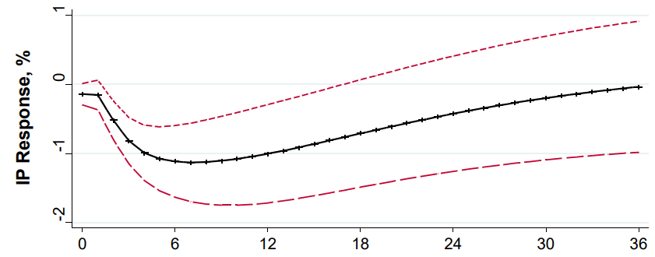


IP Response to 90-point EPU Shocks
Baker, S.R., Bloom, N. and Davis, S.J., 2016. Measuring economic policy uncertainty. The quarterly journal of economics, 131(4), pp.1593-1636.

Slide 14
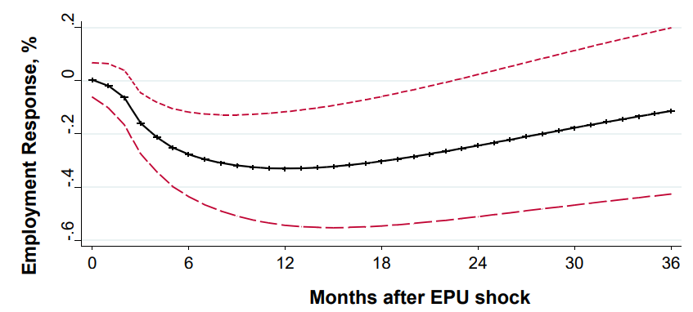
Employment Response to 90-point EPU Shocks
Baker, S.R., Bloom, N. and Davis, S.J., 2016. Measuring economic policy uncertainty. The quarterly journal of economics, 131(4), pp.1593-1636.

Slide 15
Economic Policy Uncertainty Index
Data Source: Newspaper Articles
Process: Count the number of articles related to economic policies
Index: Scale the raw count by the number of newspaper articles
Ref: https://www.policyuncertainty.com/

Slide 16
EPU Index -> E-P-U
Three buckets of words contain E-P-U buckets.
U buckets = (uncertainty, uncertain),
E buckets = (economic, economy)
P buckets = (congress, deficit, Federal Reserve, legislation)
Note that the P words are selected by audit and pilot study.

Slide 17
Training Process
Audit study: get labels from human
Pilot study: refine the training process
Selecting P term set: obtain classification report
(false positive & false negative)

Slide 18


False Positive & False Negative
This is NOT cookie!
This is a cookie!

Slide 19
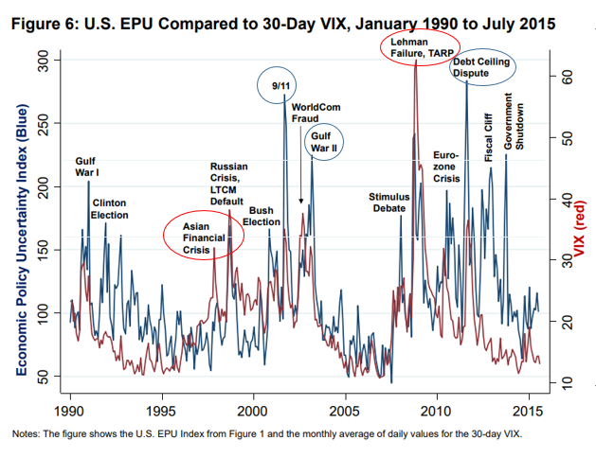
Evaluation: EPU vs VIX
EPU: Policy-focused, no explicit horizon
VIX: Stock-focused, 30-day horizon

Slide 20

Activities
Motivation: There is no EPU index for Thailand, so let’s try making one.
Data Source: Internet Articles
Buckets: Think about what words should represent Thailand, land of smile!
(USA) Three buckets of words contain E-P-U buckets.
U buckets = (uncertainty, uncertain),
E buckets = (economic, economy)
P buckets = (congress, deficit, Federal Reserve, legislation)

Slide 21
References
- Altig, D., Baker, S., Barrero, J.M., Bloom, N., Bunn, P., Chen, S., Davis, S.J., Leather, J., Meyer, B., Mihaylov, E. and Mizen, P., 2020. Economic uncertainty before and during the COVID-19 pandemic. Journal of Public Economics, 191, p.104274.
- Baker, S.R., Bloom, N., Davis, S.J. and Terry, S.J., 2020. Covid-induced economic uncertainty (No. w26983). National Bureau of Economic Research.
- Baker, S.R., Bloom, N. and Davis, S.J., 2016. Measuring economic policy uncertainty. The quarterly journal of economics, 131(4), pp.1593-1636.

Slide 22
Follow me!
Discussion Materials:
https://github.com/GoodDee/EE439_Discussion

Slide 23

See you Again!
CONGRATULATION!

